Slide 1
Enigma Machine
AES, DES, and Block Chain Ciphers
The Math Behind Modern Encryption
Or how the Nazi’s almost won WWII

Slide 2
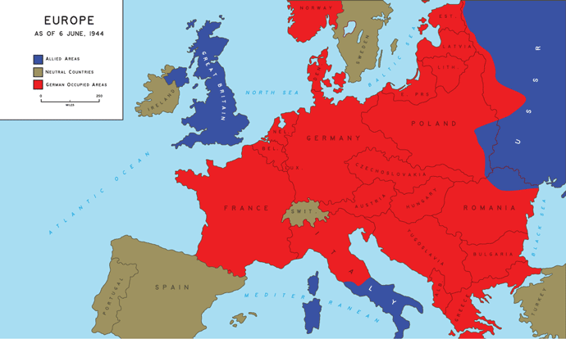
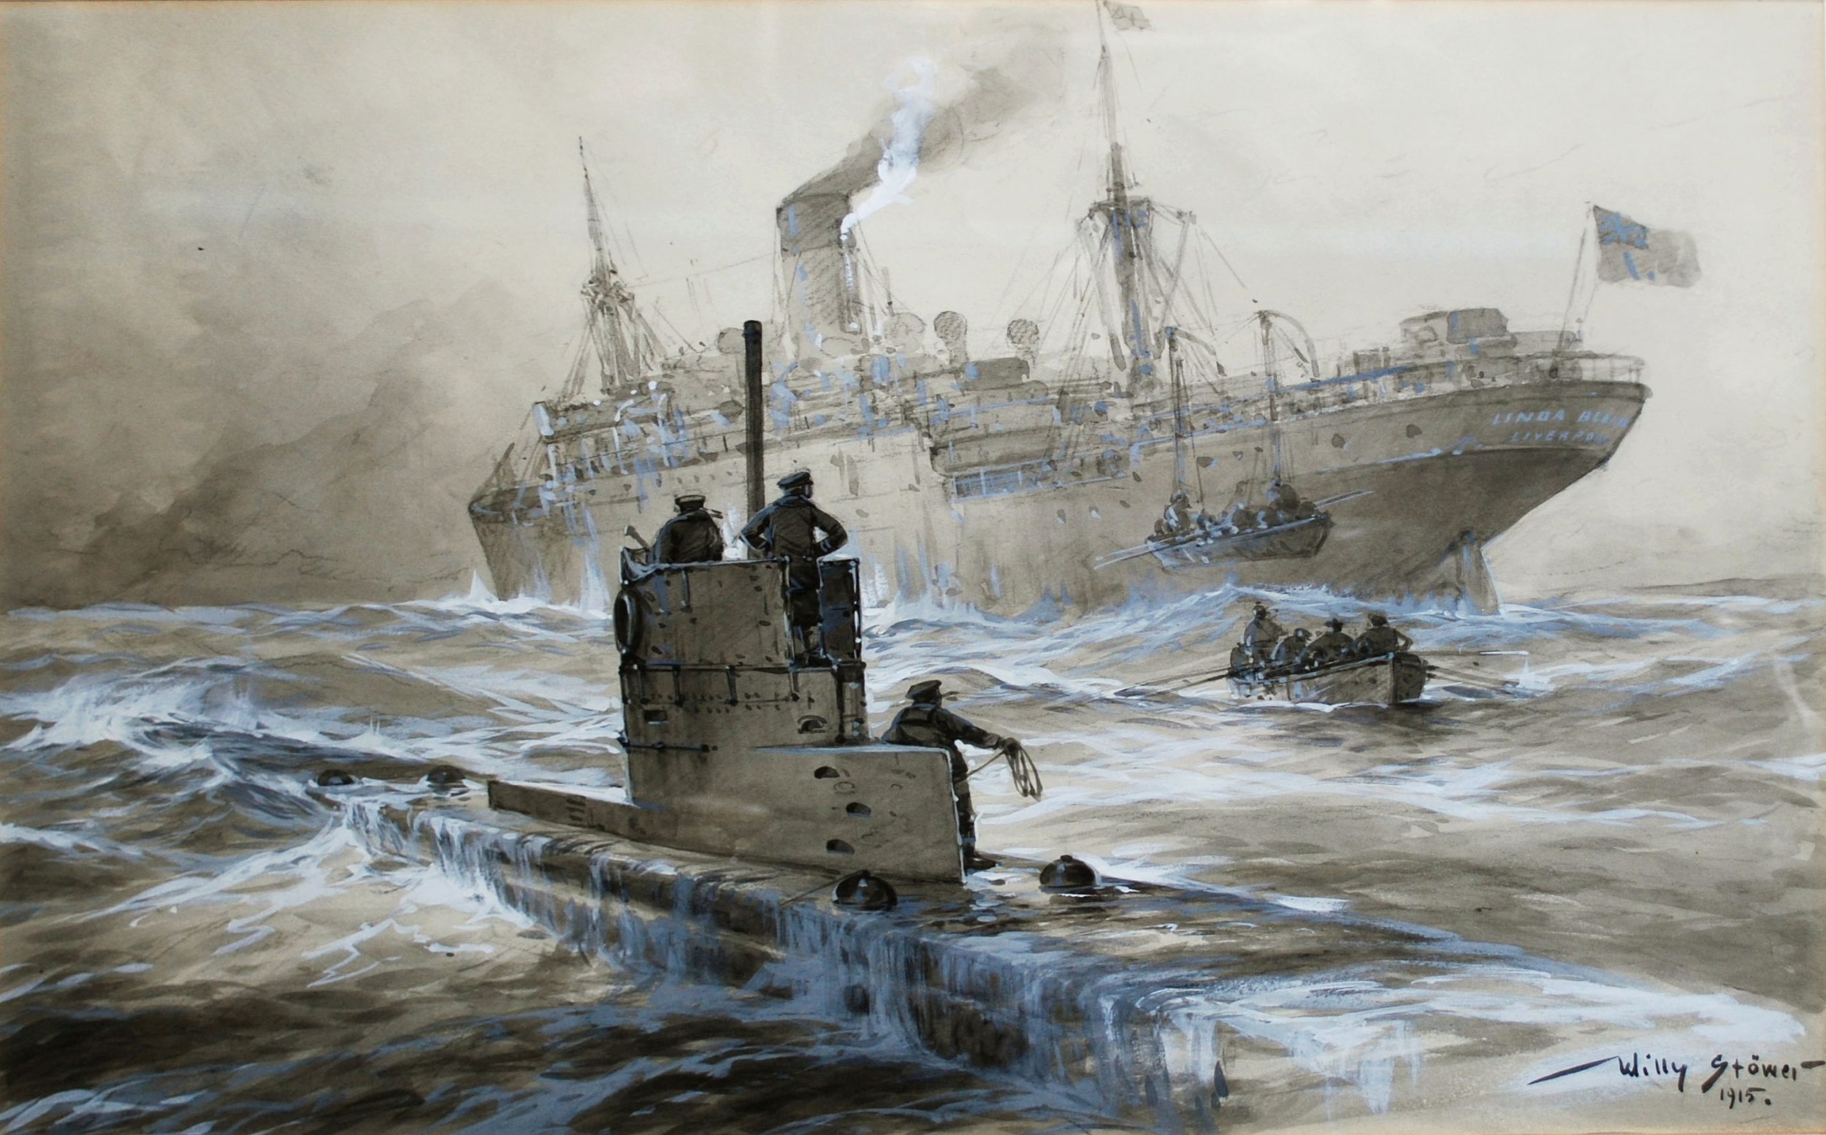
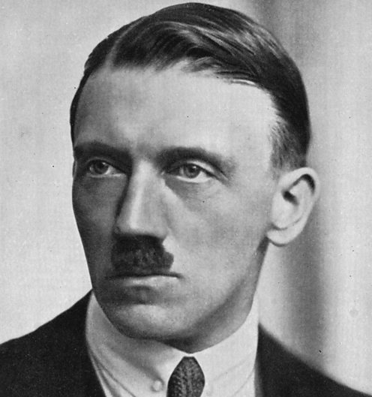
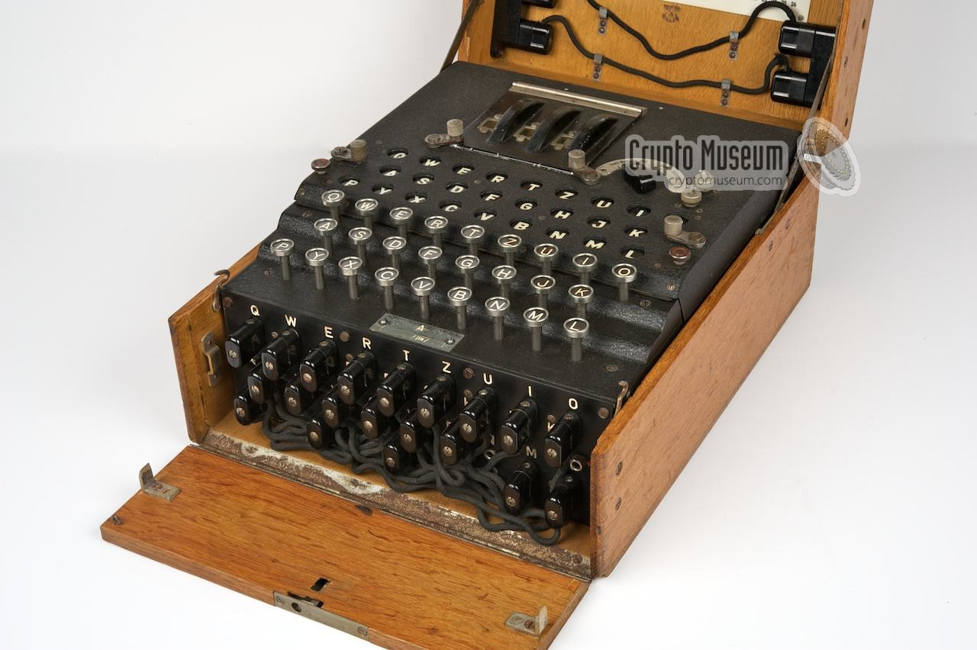
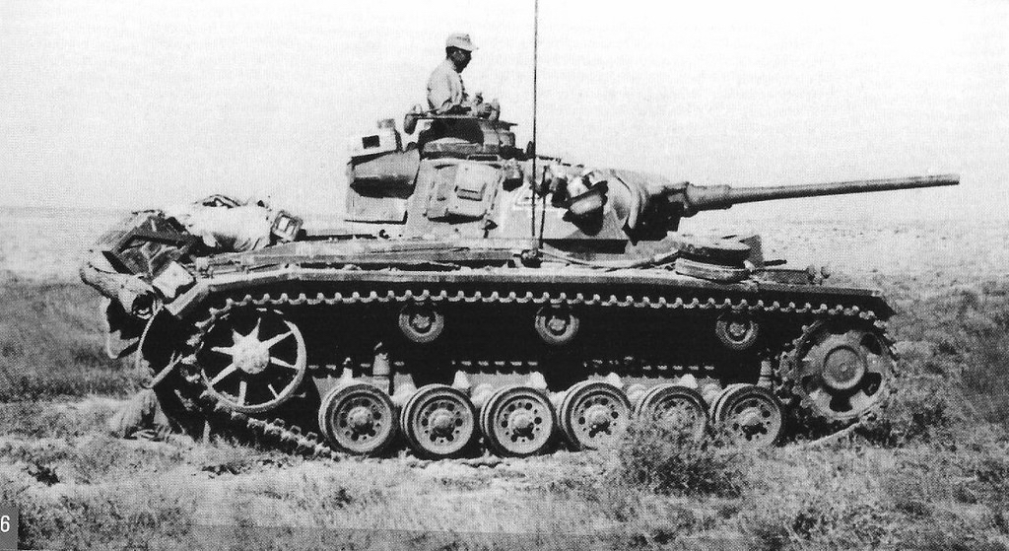
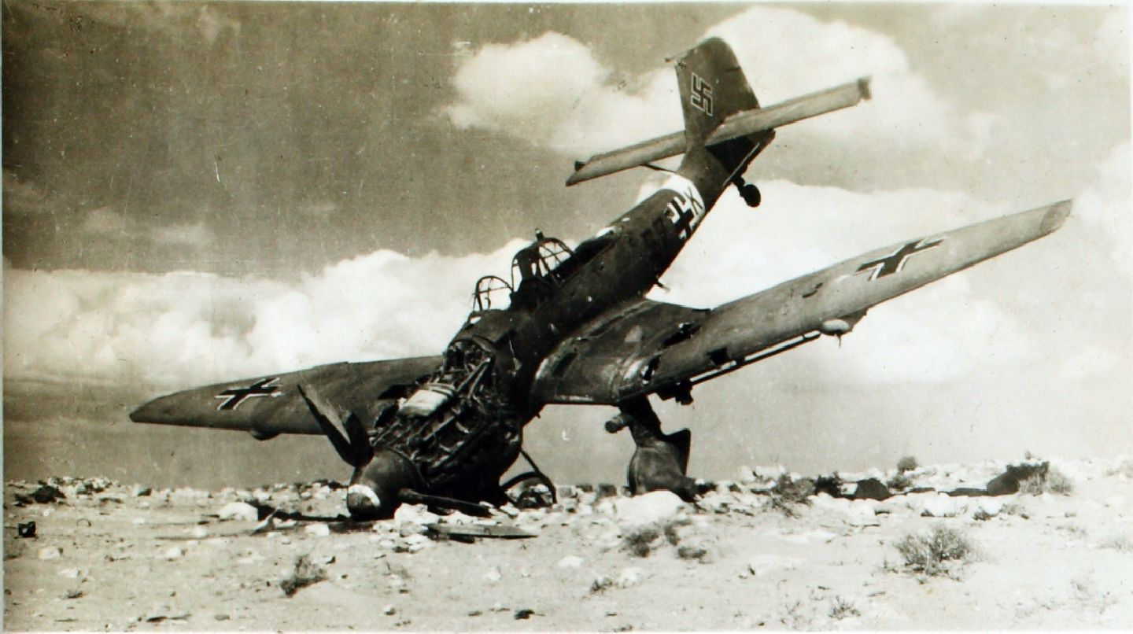
A bit of background

Slide 3
The Machine
Electro-mechanical rotor cipher
Originally designed by Arthur Scherbius at the end of World War 1
The 3 rotor design had 3,283,883,513,796,974,198,700,882,069,882,752,878,379, 955,261,095,623,685,444,055,315,226,006,433,615,627,409, 666,933,182,371,154,802,769,920,000,000,000 possible combinations
The 4 rotor had even more: 23,276,989,683,567,292,244,023,724,793,447, 227,628,130,289,261,173,376,992,586,381,072,041, 865,764,882,821,864,156,921,211,571,619,366,980,734,115, 647,633,344,328,661,729,280,000,000,000,000,000 possible combinations
The Germans never used it to the full capacity

Slide 4
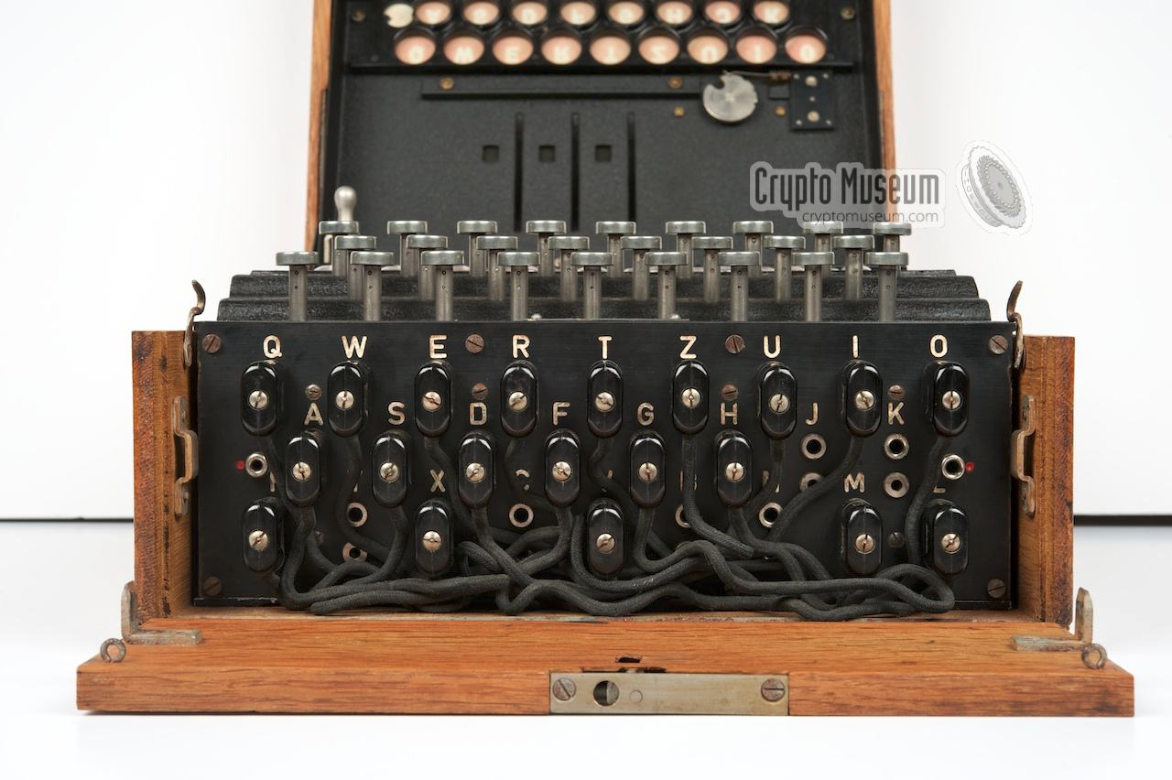
The Plugboard

Slide 5
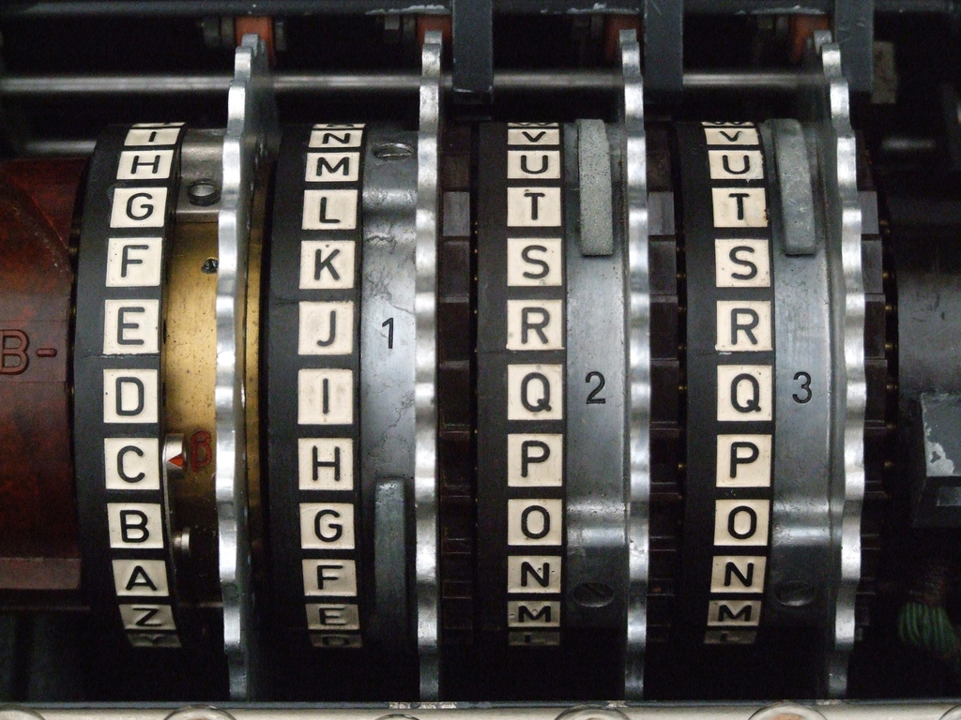
The Rotors
A selection of 5 possible rotors (3 later added by the navy) in 3 positions
Rightmost rotor moves with every keystroke
Notches cause the rotor to the left to move
Middle rotor has the double-stepping notch (it causes itself and the left rotor to move)

Slide 6
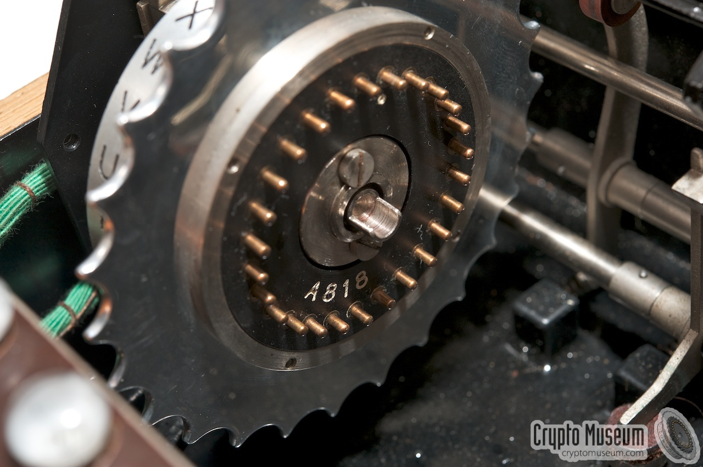
The Reflector
Selection of 2 reflectors
Scrambles and reflects the electrical signal back along the rotors
The reverse journey causes even more scrambling before going through the plugboard again

Slide 7
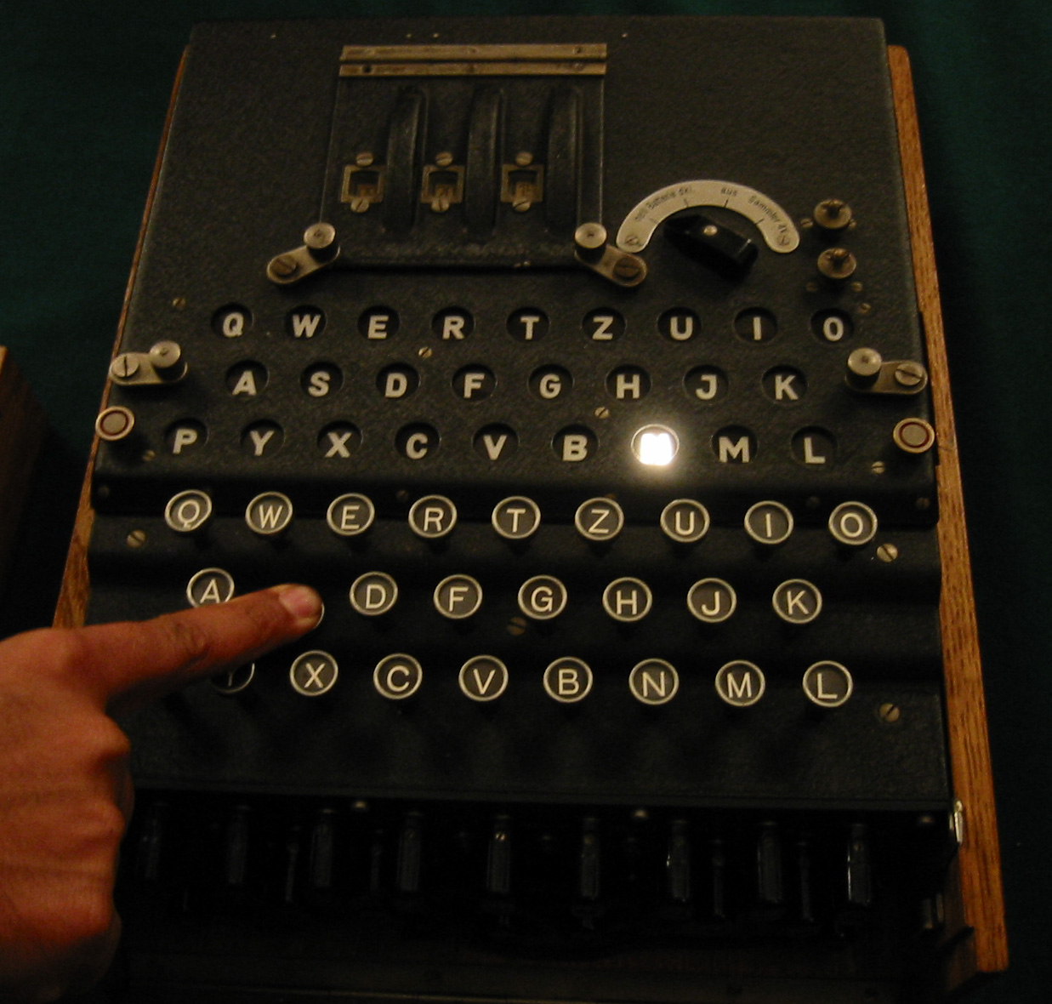
The Final Stop

Slide 8
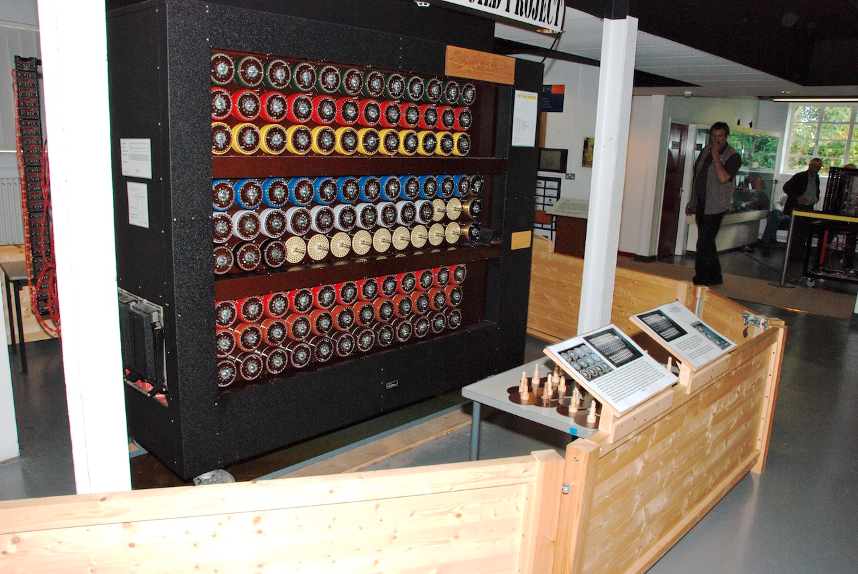
Cracking the Enigma
Polish Cipher Bureau invented the Bomba Kryptologiczna in 1938 (Germany invented 2 new rotors and the Poles couldn’t keep up)
Alan Turing invented the Bombe, which used a crib method (Germany invented a 4 rotor machine)
The U.S. developed a powerful Bombe to crack the Navy 4 rotor
U.S. and U.K. fixed the cryptographic errors in the SIGABA and Typex

Slide 9
Want to try it out?
http://enigmaco.de/enigma/enigma.html
http://enigma.louisedade.co.uk/enigma.html
Py-enigma
Or build your own...the enigma challenge
http://users.telenet.be/d.rijmenants/en/challenge.htm

Slide 10
Questions?

